Slide 1
Sensing Censorship and Censuring Censors with Censorship-Evident Publishing Systems
By: Swaminathan Ramesh
Supervised by: Dr. Ryan Henry

Slide 2
Outline
What is the problem and why should we care?
“Proofs of censorship” by Wustrow et al.
  And why is this not great
Introducing: Censorship-evident publishing systems (CEPS)
  Protocols constituting CEPS
What makes a publishing system “censorship-evident”
A template for efficient CEPS

Slide 3
What is the problem and why should you care?
Censorship
  Broadly (and very informally) defined as “some entity restricting free expression by other entities”.
Most measures deal with circumventing entities blocking access to certain locations on the internet. This is called “censorship circumvention”.
Censorship circumvention tools available include:
  Telex (now known as "Refraction Networking")
  Cirripede
  Tor, Flash proxies, Decoy routing etc.

Slide 4
The problem (contd.)
Bob posts tweet critical of a dictatorship and Twitter hosts it.
At a later point, the user wants to retrieve the tweet.
But the tweet is missing and Twitter doesn’t offer an explanation why.
How can Bob prove to others that the tweet was covertly deleted?

Slide 5
“Proofs of Censorship” by Wustrow et al.
Bob posts an encrypted tweet critical of dictatorship.
Twitter sends a digital signature of the tweet to Bob.
  Signature contains hash of tweet, “index” of tweet and a timestamp.
  Twitter also sends the hash of tweet, index of tweet and the timestamp
  The entire response from Twitter is called the “ticket”
When Bob wants to recover the tweet later:
  Bob sends a PIR query to Twitter using a random seed.
  Twitter computes the response and a signature on the response.
  Bob decodes the response and verifies it.

Slide 6
“Proofs of Censorship” (contd.)
How does Bob verify the response?
  Checks that timestamp of the response is after the timestamp of tweet
  Verifies the signature on the ticket
  Recomputes the PIR query using random seed.
  And uses this query to verify the signature on the response.
If any one of the steps fail, then the tweet was censored
How does Bob’s friend, Alice, verify the response?
  Bob publishes the seed for PIR query, ticket and response from Twitter
  Alice does the same steps as Bob did to verify
  Viola, transferable proof of censorship!

Slide 7
Looks like Wustrow et al. solved it, so what now?
Wustrow et al.’s construction requires user to upload encrypted file.
  Increases computation cost for the client.
Response is computed over the entire database.
  Computationally intensive for the server
Verification requires extraction of the tweet from Twitter’s response
  Decoding PIR response can be expensive depending on the PIR protocol used.

Slide 8
Introducing: Censorship-evident Publishing Systems
A generalization of “Proofs of Censorship”
Comes with a formal model (YAY!)
And provable security properties (WHEEEE!!!)
While providing a transferable proof if content is censored!

Slide 9
Protocols in CEPS
Parties involved: Content hosting service (server) and users (clients).
Database modeled like in regular PIR protocols.
Setup:
  Sets up agreed upon long-lived public parameters between servers and clients.
Post-Receipt protocol:
  Initiated by a client to post a file to server.
  Outputs a “ticket” upon success.
  File stored at index I in database.

Slide 10
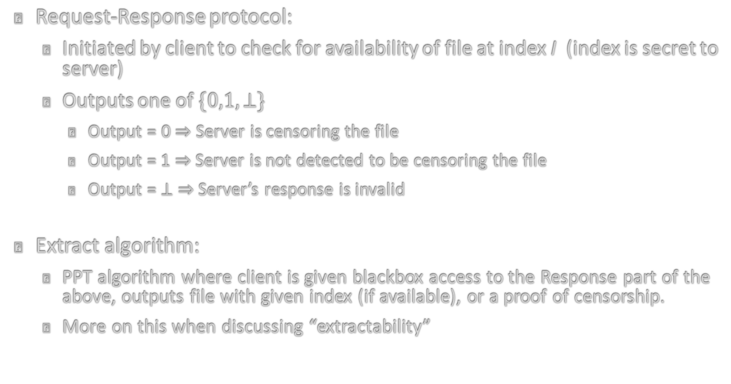
Protocols (contd.)
Request-Response protocol:
  Initiated by client to check for availability of file at index I (index is secret to server)
  Outputs one of $\{0,1,⊥\}$
    Output = 0 $⇒$ Server is censoring the file
    Output = 1 $⇒$ Server is not detected to be censoring the file
    Output = $⊥$ $⇒$ Server’s response is invalid
Extract algorithm:
  PPT algorithm where client is given blackbox access to the Response part of the above, outputs file with given index (if available), or a proof of censorship.
  More on this when discussing “extractability”

Slide 11
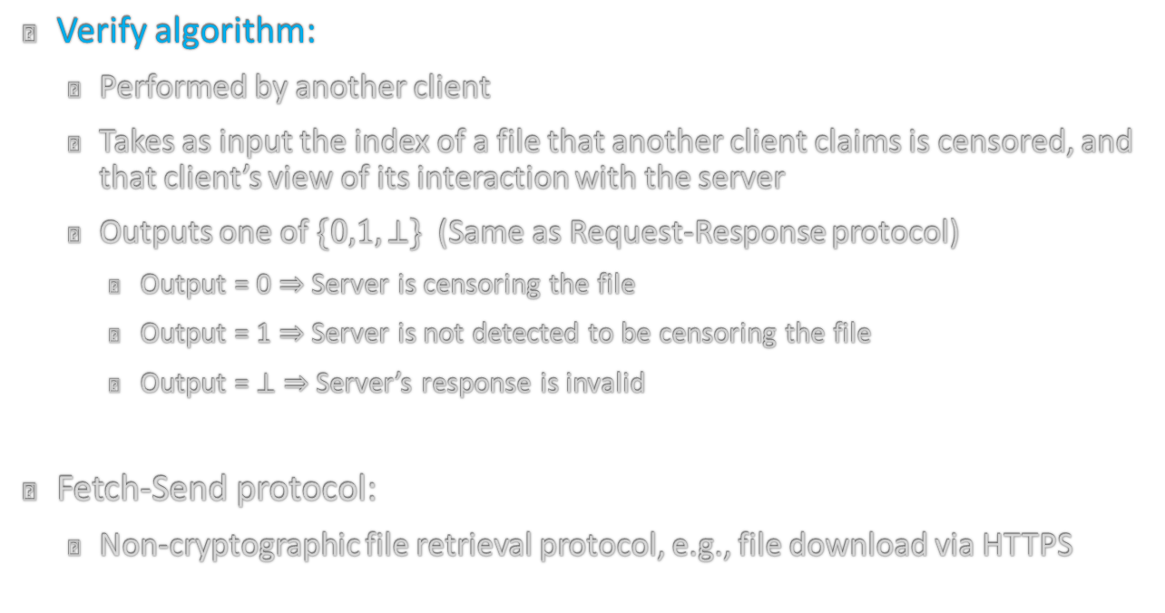
Protocols (contd.)
Verify algorithm:
  Performed by another client
  Takes as input the index of a file that another client claims is censored, and that client’s view of its interaction with the server
  Outputs one of $\{0,1,⊥\}$ (Same as Request-Response protocol)
    Output = 0 $⇒$ Server is censoring the file
    Output = 1 $⇒$ Server is not detected to be censoring the file
    Output = $⊥$ $⇒$ Server’s response is invalid
Fetch-Send protocol:
  Non-cryptographic file retrieval protocol, e.g., file download via HTTPS

Slide 12
Security guarantees of CEPS
Existential unforgeability:
  Ensures no (dishonest) party can forge a valid server response during the Request-Response phase.
  Similar to EXT-UF property for digital signatures
  EXT-UF game:
    Attacker and Challenger get public parameters
    Attacker and Challenger engage in polynomially many rounds of Request-Response protocol
    Attacker outputs one extra protocol view.
  Attacker wins if all protocol views are accepted as “valid” by the Verify algorithm.

Slide 13
Security properties (contd.)
Selective Inauthenticity Resistance:
  Ensures server cannot selectively respond to client queries in Request-Response protocol.
  Modeled after selective failure blindness property of blind signatures.
  SI game involves attacker, two challenger instances and a Verify oracle.
    Attacker chooses two indices i_{o},i₁.
    User instances toss a fair coin and each implement an instance of the Request part of the Request-Response protocol.
    First user operates on i_{b}, second user operates on i_{1-b}.
    Both instances eventually produce responses R_{b} , R_{1-b} and the responses are input to the Verify oracle.

Slide 14
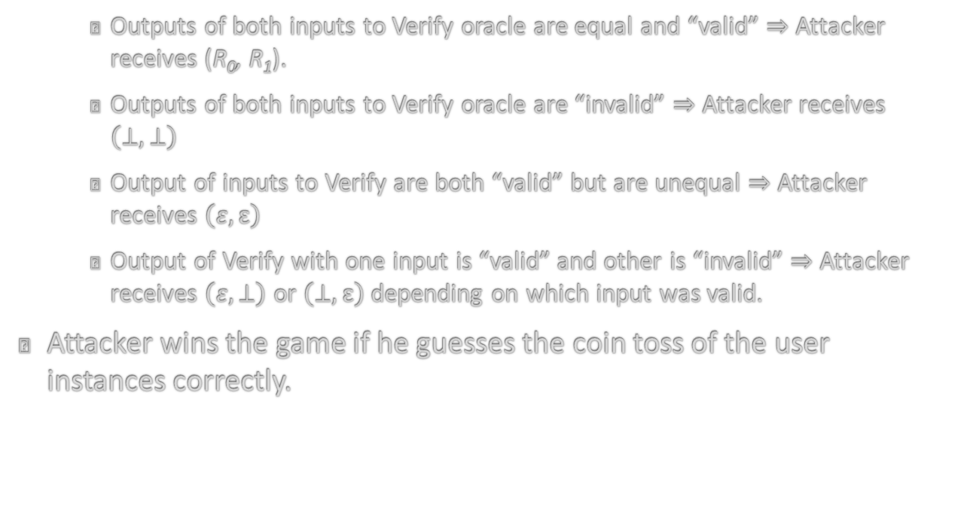
Security properties (contd.)
    Outputs of both inputs to Verify oracle are equal and “valid” $⇒$ Attacker receives (R₀, R₁).
    Outputs of both inputs to Verify oracle are “invalid” $⇒$ Attacker receives $\left(⊥,⊥\right)$
    Output of inputs to Verify are both “valid” but are unequal $⇒$ Attacker receives $\left(ε,ε\right)$
    Output of Verify with one input is “valid” and other is “invalid” $⇒$ Attacker receives $\left(ε,⊥\right)$ or $\left(⊥,ε\right)$ depending on which input was valid.
Attacker wins the game if he guesses the coin toss of the user instances correctly.

Slide 15
Security properties (contd.)
Extractability:
  Modeled after extractability defined by Bellare and Goldreich in the context of ZKPoKs.
  Extractability implies that given blackbox access to the Request-Response algorithm and a CEPS query, a user can:
    Produce the file corresponding to the CEPS query, or,
    Produce a proof of censorship of the corresponding file

Slide 16
A template for efficient CEPS
Requires the following building blocks:
  Existentially unforgeable signature scheme (for ensuring EXT-UF property of CEPS)
  An “efficient” Computational PIR scheme
  Computationally binding vector commitment scheme
  CSPRNG and a random oracle
Setup: Generate long lived public parameters for all the primitives that the server and clients can use.

Slide 17
Efficient CEPS (contd.)
Post-Receipt protocol:
  Client uploads a file to server.
  Server stores it in database and computes a commitment
  Ticket contains:
    index the file is stored at,
    timestamp when it was uploaded,
    the commitment, and
    a signature on the commitment.

Slide 18
Efficient CEPS (contd.)
Request-Response protocol:
  Client generates two seeds using the random oracle, using the index of the file and timestamp when request is generated.
  Client uses first seed to generate PIR query
  Server generates a “smaller” database using the second seed
    Server uses second seed as input to CSPRNG
    Uses output of CSPRNG as column indices
  Server then computes PIR response on the smaller database and a signature on the response
  Client verifies the signature on response and the response against commitment in the ticket.
    If this step fails, publishes response, ticket and timestamp

Slide 19
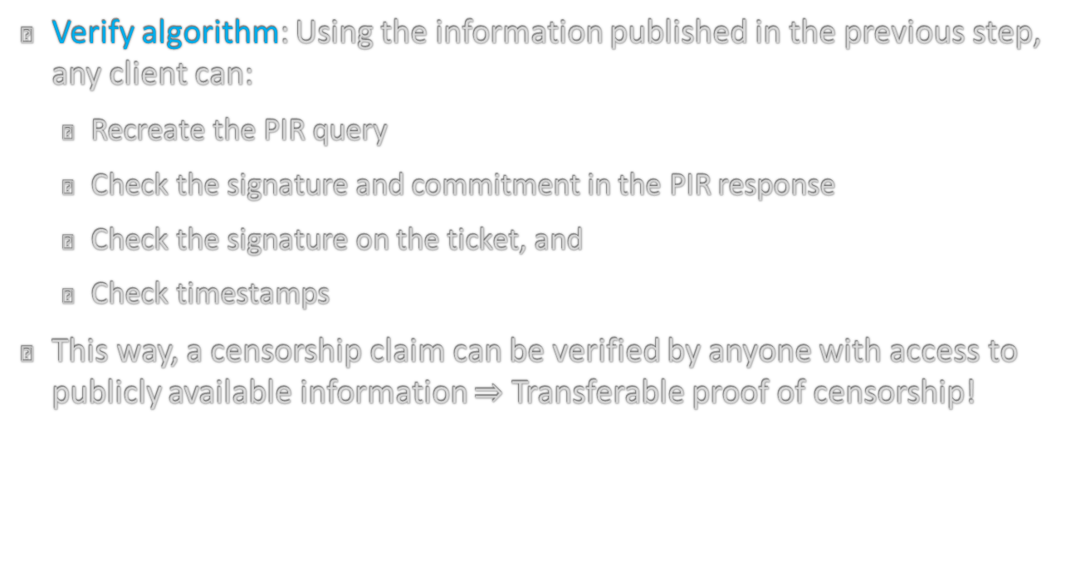
Efficient CEPS (contd.)
Verify algorithm: Using the information published in the previous step, any client can:
  Recreate the PIR query
  Check the signature and commitment in the PIR response
  Check the signature on the ticket, and
  Check timestamps
This way, a censorship claim can be verified by anyone with access to publicly available information $⇒$ Transferable proof of censorship!

Slide 20
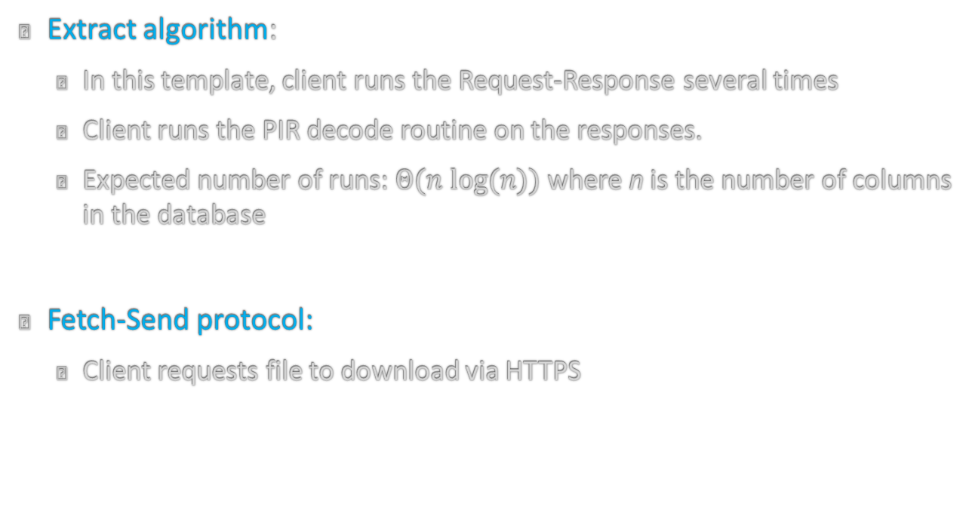
Efficient CEPS (contd.)
Extract algorithm:
  In this template, client runs the Request-Response several times
  Client runs the PIR decode routine on the responses.
  Expected number of runs: $Θ(n log⁡(n))$ where n is the number of columns in the database
Fetch-Send protocol:
  Client requests file to download via HTTPS

Slide 21
So…why is this better?
Decouples verification from extraction
  Does not require recovering the entire file via PIR to detect censorship
  Allows bypassing known PIR impossibility results
Does not require extraction to retrieve files
  Fetch-Send protocol is lightweight and does not have any privacy requirements

